Slide 1


Java SE
(Core JAVA)
Lecture-17

Slide 2
Today’s Agenda
Argument passing.
Passing variables
Passing array reference.
Returning array reference.

Slide 3
Argument Passing
Java only allows pass by value, there is no pass by reference. But yes references are passed but same as pass by value.
So, we can say that in Java we can pass arguments as…
Passing variable as Argument.
Passing references as argument.

Slide 4
Passing variable as argument
In java also on passing variables as argument, a copy gets generated which is termed as formal argument.
The method performs all operation on these formal arguments and hence no change can be made on actual arguments.
Let us understand this through an example

Slide 5

Example
class Demo
{
public void increment(int x, int y)
{
x++;
y++;
}
}
class Test
{
public static void main(String [ ] args)
{
Demo D=new Demo();
int x=10, y=20;
S.O.P(“Before Increment x= ”+x+“y= ”+y);
D.increment(x, y);
S.O.P(“After Increment x= ”+x+“y= ”+y);
}
}

Slide 6
Improved Program Passing Reference
class Demo
{
private int x;
private int y;
public Demo(int i, int j)
{
x=i;
y=j;
}
public void increment(Demo D)
{
D.x++;
D.y++;
}
public void show( )
{
System.out.println(“x= ”+x);
System.out.println(“y= ”+y);
}
}

Slide 7
class Test
{
public static void main(String [ ] args)
{
Demo D=new Demo(10,20);
D.show( );
D.increment(D);
D.show( );
}
}

Slide 8

Execise
WAP to swap two integer data members of a class. Later you can modify it to accept input from the user.
Sample Output :-

Slide 9
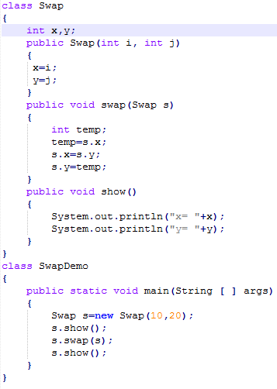
Solution

Slide 10

Passing Array Reference
class Demo
{
public void doubler(int [ ] brr)
{
for(int i=0; i<brr.length; i++)
brr[i]=brr[i]*2;
}
}
class Test
{
public static void main(String [ ] args)
{
int [] arr={10,20,30,40,50};
Demo d=new Demo( );
d.doubler(arr);
for(int i=0;i<arr.length;i++)
S.O.P(arr[i]);
}
}

Slide 11
Returning Array Reference
class Demo
{
public int[ ] createArray(int n)
{
int [ ] brr=new int [n];
return brr;
}
}
class Test
{
public static void main(String [ ] args)
{
Demo d=new Demo( );
int [ ] arr=d.createArray(5);
System.out.println(“Length of array is ”+arr.length);
}
}

Slide 12
Practice
WAP to declare an integer array of 10 elements and ask the user to input values in it. Now again ask the user to input another number and pass the array and number to a method called search. This method should be defined in class called ArraySearch. The method should return all the positions where the number is occurring. Assuming that the number will occur maximum 5 times.
Design another method in the same class called count() which should return total number of elements in the array which are greater than the number passed, smaller than the number passed and equal to the number passed.

Slide 13

End Of Lecture 17
For any queries mail us @: scalive4u@gmail.com
Call us @ : 0755-4271659, 7879165533
Agenda for Next Lecture:
Using “this” keyword.
Using “static” keyword.

